Slide 1
Serverless Computing: Current Trends and Open Problems arxiv: June 2017
Authors: Ioana Baldini, Paul Castro, Kerry Chang, Perry Cheng, Stephen Fink, Vatche Ishakian, Nick Mitchell, Vinod Muthusamy, Rodric Rabbah, Aleksander Slominski, Philippe Suter
Presented by: Arjun Prakash

Slide 2
Contents of the Paper:
Introduction
Defining Serverless
Evolution
Architecture
Survey of serverless platforms
Benefits and Drawbacks
Current State of Serverless Platforms
Programming Model
Ecosystem
Tools and Frameworks
Use cases and Workloads
Event Processing
API composition
API aggregation to reduce API calls
Discussion
Challenges and Open Problems
System Level Challenges
Programming model and DevOps challenges
Open Research problems
Conclusions

Slide 3
Serverless Computing model has servers. It’s a smart way of microservice orchestration.

Slide 4
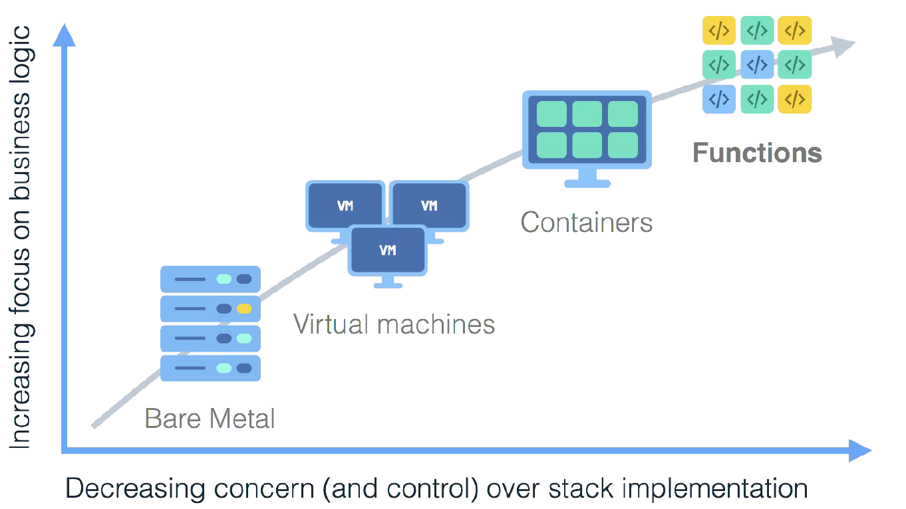

Slide 5
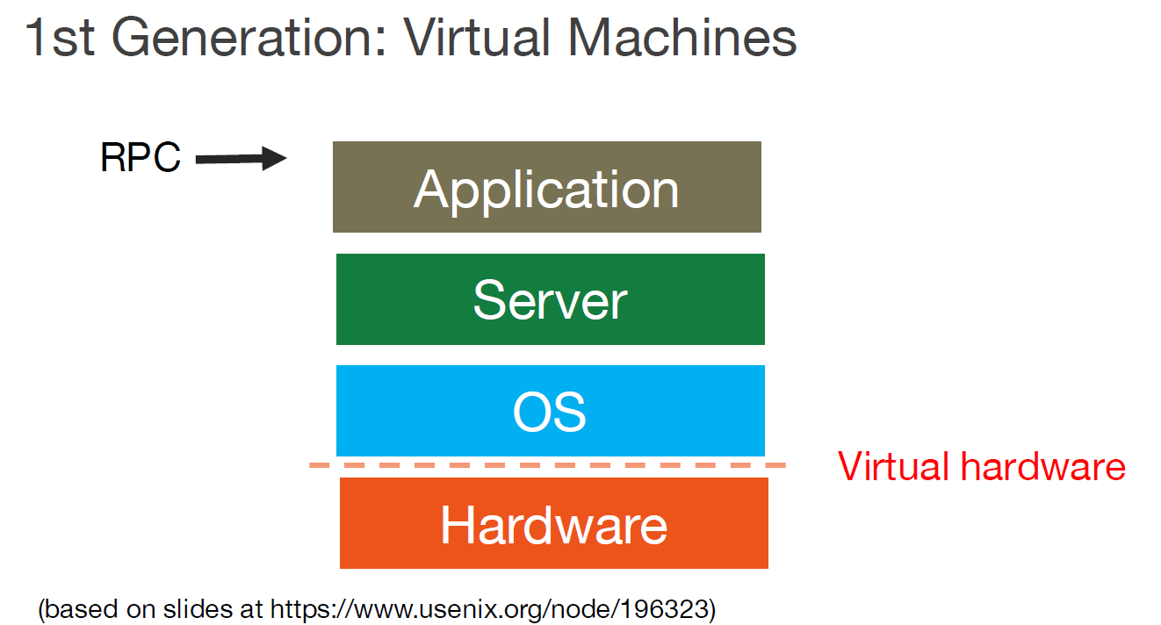

Slide 6
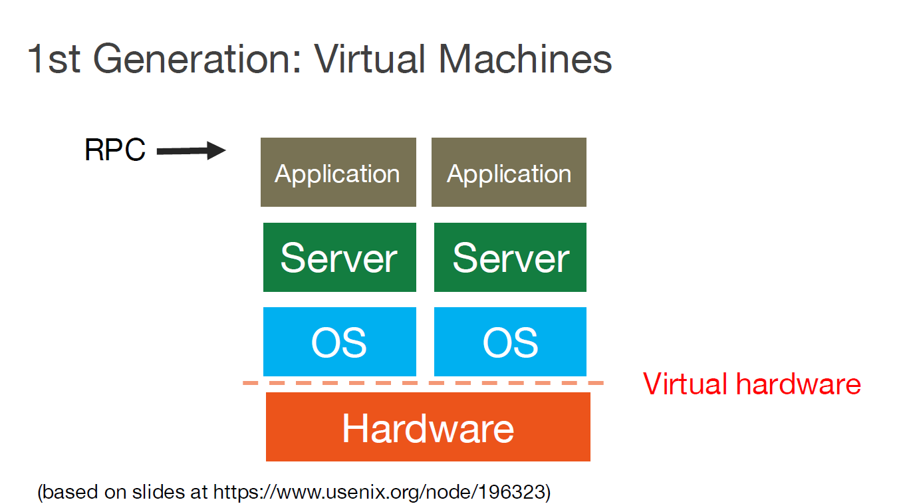

Slide 7
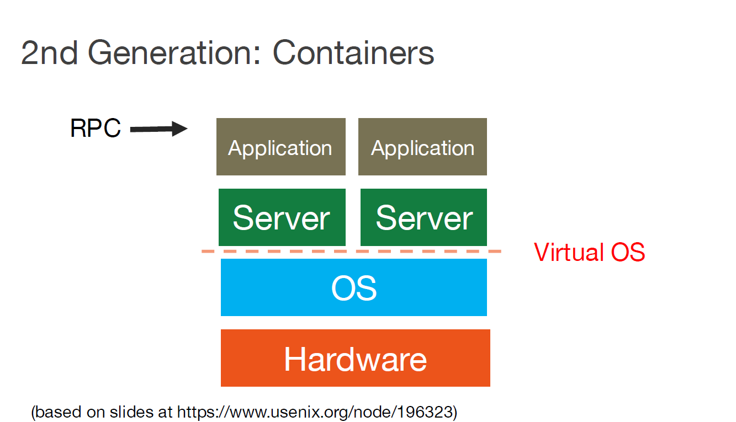

Slide 8
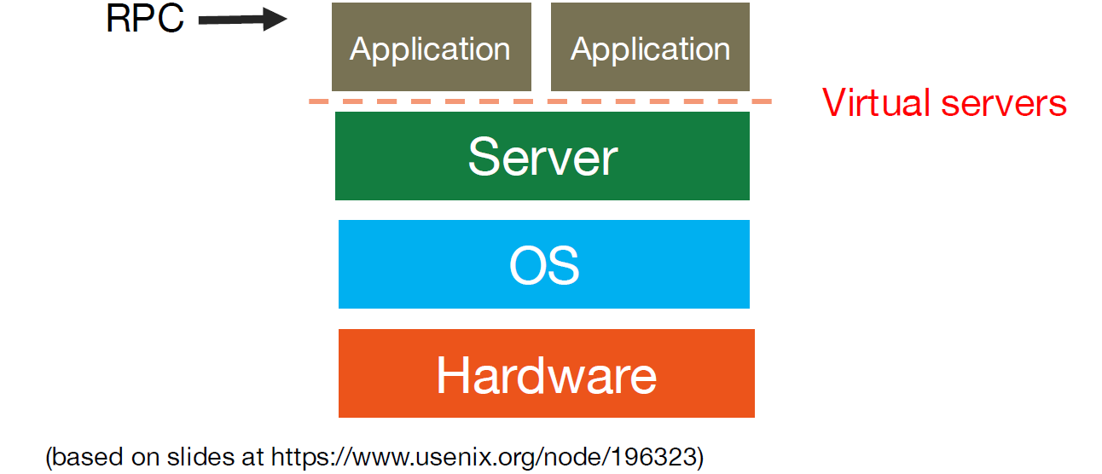
3rd Generation: Serverless functions

Slide 9
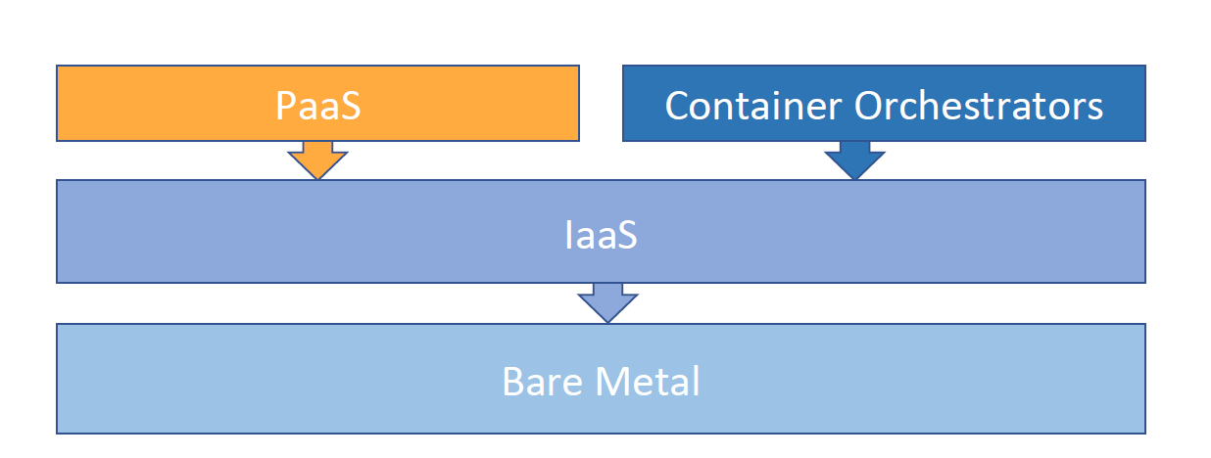
Evolution of Serverless

Slide 10
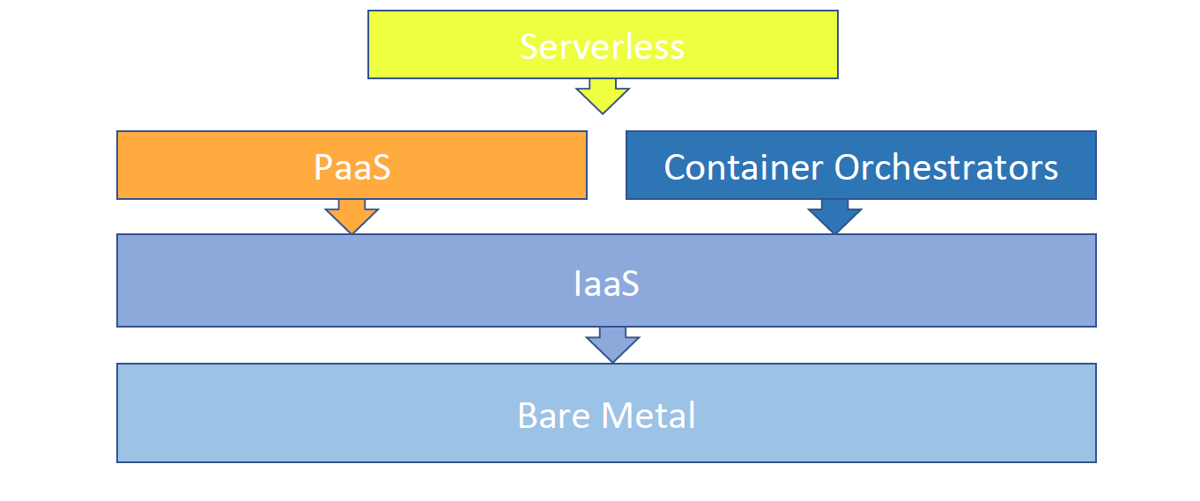
Enter Serverless

Slide 11
What is Serverless - formal definition

Slide 12
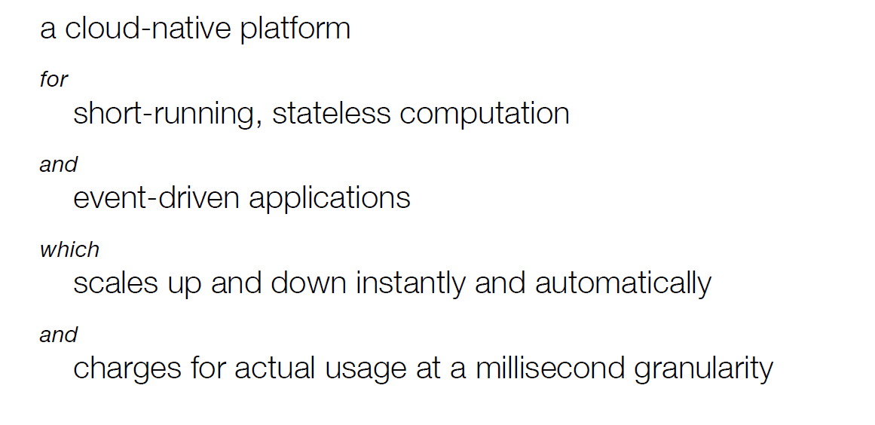
What is Serverless

Slide 13
What is Serverless

Slide 14
What is Serverless

Slide 15
What is Serverless

Slide 16
What is Serverless

Slide 17
Evolution of Cloud Computing
Serverless computing is an evolution of cloud computing service models –from Infrastructure-as-a-Service (IaaS) to Platform-as-a-Service (PaaS) to Function-as-a-Service (FaaS).

Slide 18
Evolution of Cloud Computing
Serverless computing is an evolution of cloud computing service models –from Infrastructure-as-a-Service (IaaS) to Platform-as-a-Service (PaaS) to Function-as-a-Service (FaaS).
While IaaS abstracts the underlying infrastructure to provide virtual machines for ready consumption and PaaS abstracts the entire operating system and middleware layer to provide the application development platform,

Slide 19
Evolution of Cloud Computing
Serverless computing is an evolution of cloud computing service models –from Infrastructure-as-a-Service (IaaS) to Platform-as-a-Service (PaaS) to Function-as-a-Service (FaaS).
While IaaS abstracts the underlying infrastructure to provide virtual machines for ready consumption and PaaS abstracts the entire operating system and middleware layer to provide the application development platform, FaaS goes one step further in terms of abstracting the entire programming runtime to provide options to readily deploy a piece of code and execute without worrying about its deployment.

Slide 20
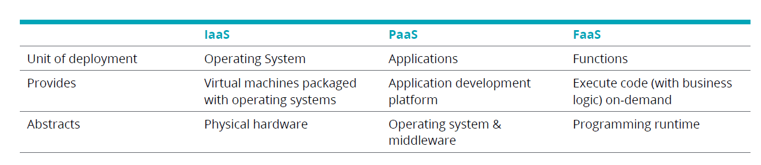
IaaS vs. PaaS vs. FaaS

Slide 21
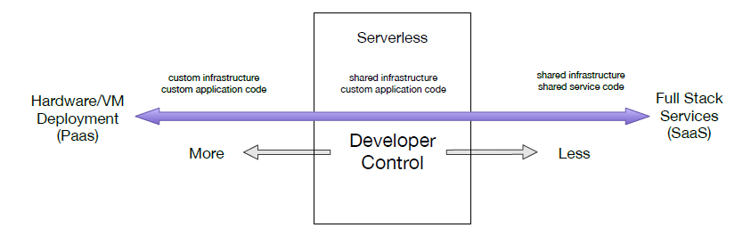
Developer control and Serverless computing

Slide 22
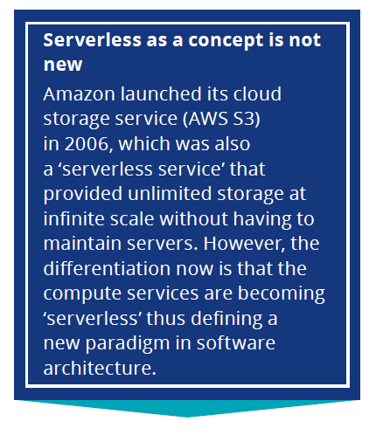
Fun fact..

Slide 23
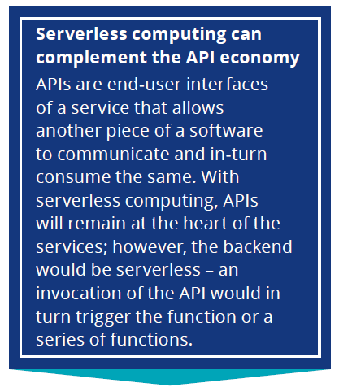
Fun fact..

Slide 24
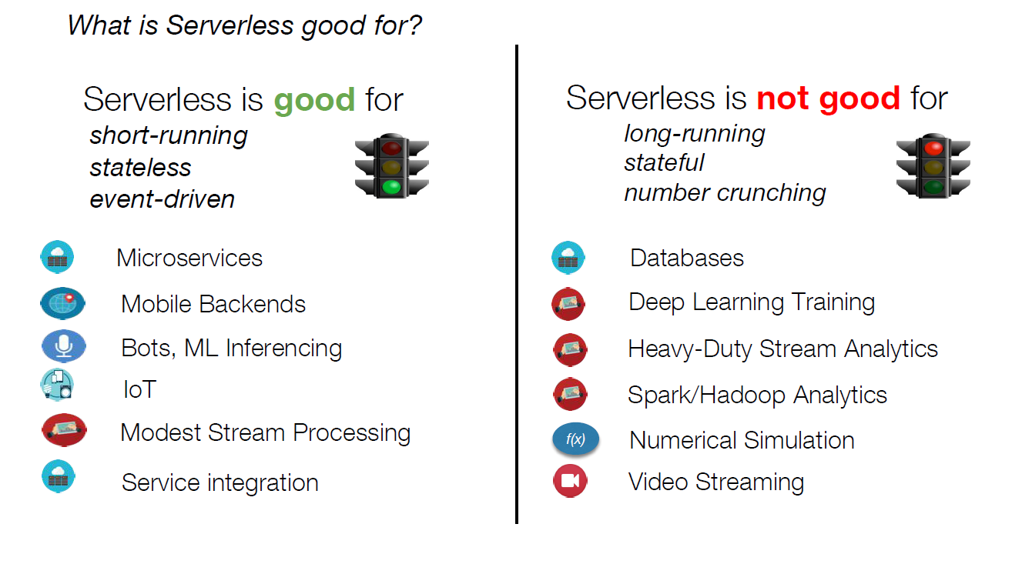

Slide 26
Not all application or service can be delivered in a serverless
model – we believe the future enterprise IT landscape will be a hybrid landscape. - Delloite

Slide 27
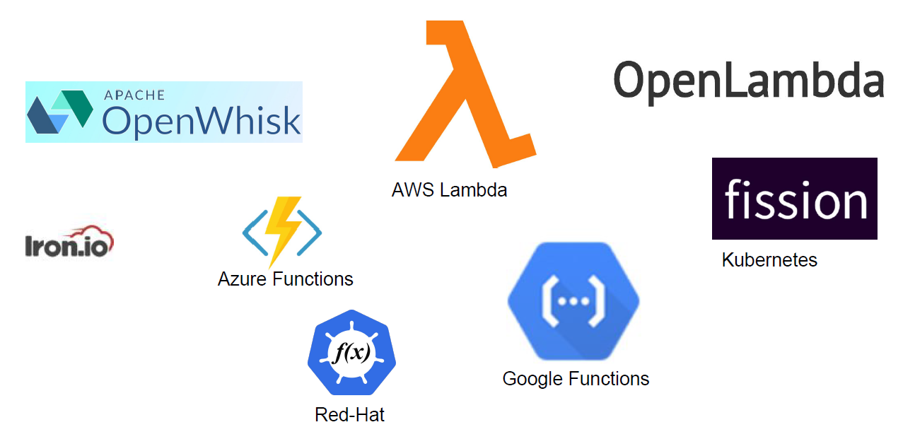
Current Platforms for Serverless
1st

Slide 28
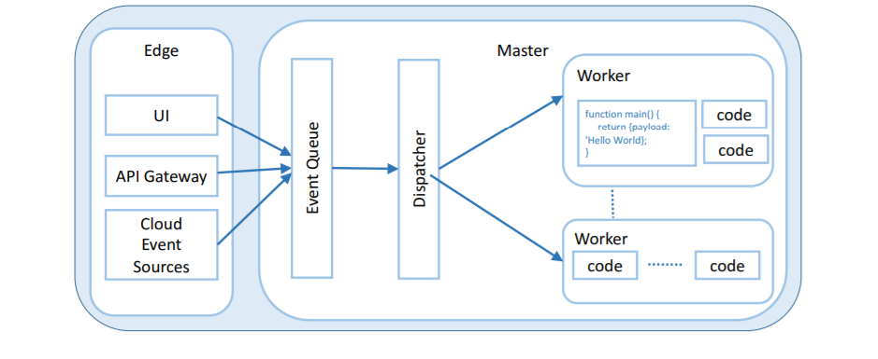
Serverless platform architecture

Slide 29
Characteristics of Serverless computing
Cost: Sub-second billing. Ex. Lambda: 3,600 threads for one second → 10¢
Performance: Scalability of functions is taken care of by the provider. However, the amount of concurrent requests to a specific function may vary for different providers.
Monitoring and debugging: Tracing errors in order to identify problems depends on the monitoring capabilities (such as log files, invocation count, etc) provider be the provider.
Security: Access management has a fine-grained access policy where each function can be assigned its own security entity.

Slide 30
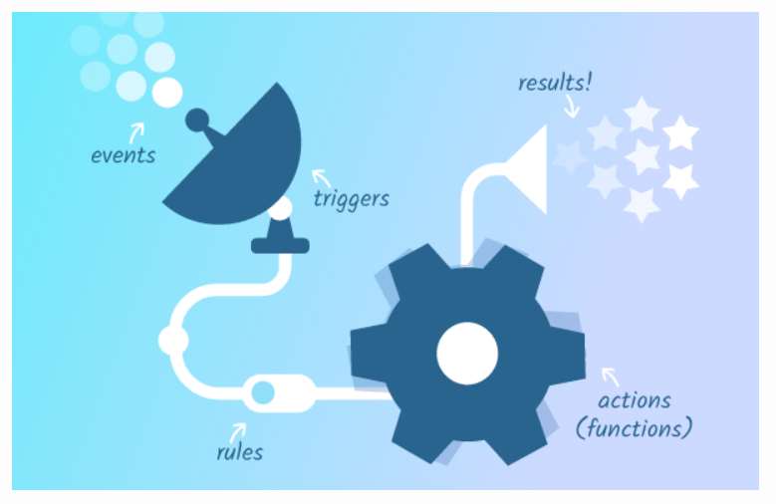
Apace OpenWhisk – by IBM and Adobe

Slide 31
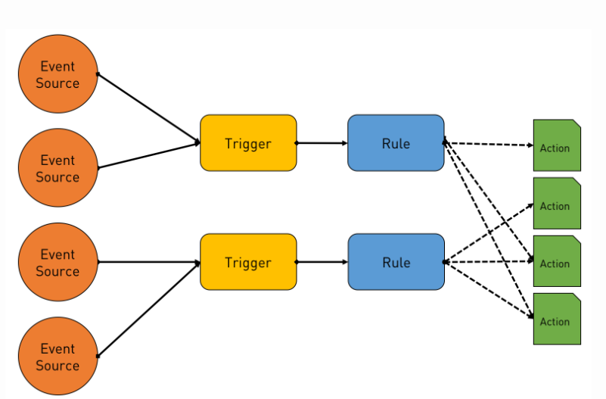
Apache OpenWhisk – by IBM and Adobe

Slide 32
Apache OpenWhisk - Action
Developers write standalone functions that are uploaded as Actions, which is completely autonomous and independent of the event sources.

Slide 33
Apache OpenWhisk - Trigger
Triggers, which are endpoints that are explicitly called by event sources such as databases, stream processing engines, file systems, and line-of-business applications.

Slide 34
Apache OpenWhisk - Rules
But, how do developers bind Actions with Triggers? That’s where the Rules come into the play. They create a loosely coupled association between them.

Slide 35
Apache OpenWhisk: ACTIONS
Apache OpenWhisk is designed to act as an asynchronous and loosely coupled execution environment that can run functions against external triggers.
Developers write standalone functions that are uploaded as Actions, which is completely autonomous and independent of the event sources.
They can be invoked as long as an event source passes the right set of parameters that are essential for the invocation.

Slide 36
Apache OpenWhisk: TRIGGERS
Triggers, which are endpoints that are explicitly called by event sources such as databases, stream processing engines, file systems, and line-of-business applications.
An Action is independent of a Trigger, which means that it may or may not have any Action bound to it.
The set of Actions bound to a Trigger is discovered and executed only at runtime.

Slide 37
Apache OpenWhisk: Rules
But, how do developers bind Actions with Triggers? That’s where the Rules come into the play. They create a loosely coupled association between them.

Slide 38
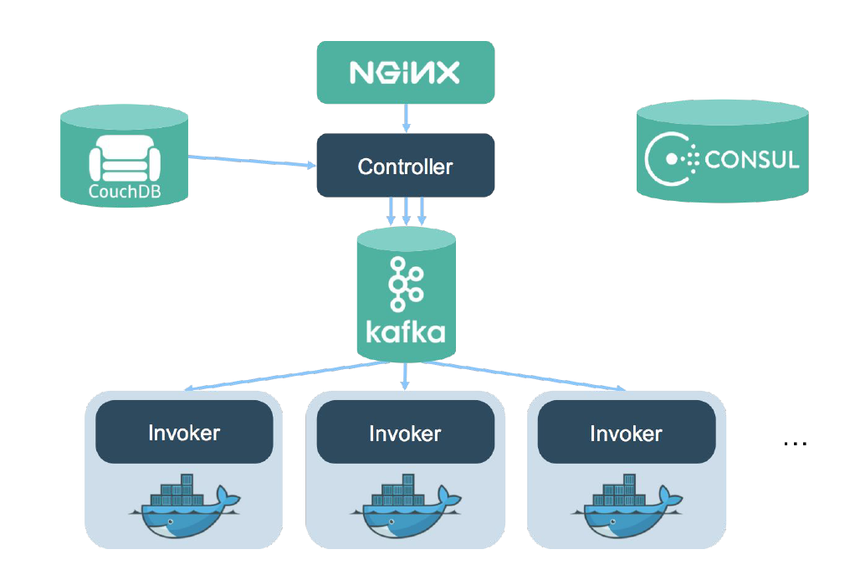
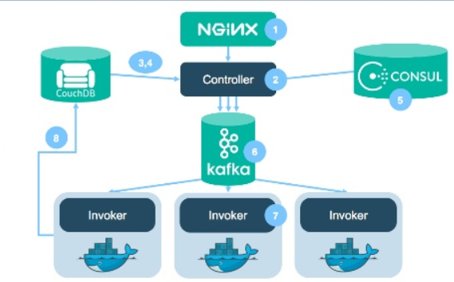
OpenWhisk – Backend architecture
Essentially microservices deployed in Docker container
Why Docker? - for isolation, portability

Slide 39
OpenWhisk – Action Invocation
(1) Nginx – action enters here first
(2) Brain of the backend.
(3,4) Authentication, Parameters for an Action needed
(5) Consul – Service Discovery. Find the right Slave (invoker)!
(6) Kafka sends Invokers the message through the Message Bus.
(7) Execute actions
(8) Store Results in the CouchDB

Slide 40
Benefits:
Instead of (IaaS) latency, scalability, and elasticity, spend time in writing code which is efficient and modular.
From consumer perspective, a cloud developer no longer needs to provision and manage servers, VMs, or containers as the basic computational building block for offering distributed services. Instead the focus is on the business logic.

Slide 41


Benefits
Instead of (IaaS) latency, scalability, and elasticity, spend time in writing code which is efficient and modular.
From consumer perspective, a cloud developer no longer needs to provision and manage servers, VMs, or containers as the basic computational building block for offering distributed services. Instead the focus is on the business logic.

Slide 42
Programming Model
Customer is no longer concerned with the nuts-and-bolts of server maintenance. Instead, customer focuses more on their logic.
In Serverless Programming model, the cloud provider acts a server dynamically managing the machine resources.
Pricing is based on resources.
Single web pages use vast ecosystem of cloud data bases and authentication services. So, Serverless Computing uses FaaS.
Serverless computing make use of stateless functions.
Notes:
Cloud elasticity:

Slide 43
Stateless functions in Serverless computing
Stateless compute containers are event-triggered, ephemeral (may only last for one invocation), and fully managed by a third party.
As states are not maintained, developers can write code in the function in a particular context to retrieve and update needed state.
Context objects are widely used:
Notes:
context object that represents the environment in which the function is running
a function written in JavaScript could take the input, as a JSON object, as the first parameter, and context as the second.

Slide 44
Programming Model – Ecosystem
Due to stateless nature of serverless functions, an ecosystem that supports different functionalities is required.
FaaS breaks code into small functions and run functions using different API’s.
To use all API’s from a single platform, an Ecosystem is required.
Problem:
Ecosystem enables Ease of Integration and Fast Deployment at the expense of vendor Lock-in.

Slide 45
Programming Model – Tools and frameworks
Managing multiple functions is more convenient when a framework has been established.
Frameworks reduce the complexity of the serverless model.
Frameworks logically group functions together to deploy and update them as a unit.
Framework also makes it easier to deploy and update functions that are not bound to on serverless provider.
Notes:
Low level detail is kept hidden from the user with the help of abstraction.
Zappa and Chalice @app.route decorator to make it possible to write py code that looks like webserver but can be deployed as a serverless function.

Slide 46
Use cases and workloads
Functionality perspective:
Serverless and more traditional architectures are used interchangeably.
Use of serverless is based non-functional requirements such as cost and application workloads.
Cost perspective:
Bursty Workload: Developer offloads the functionality to the platform. So no cost to customer when system idle.
Computation Intensive Workload: Generally, the price of a function execution is proportional to the running time of function.
Notes:
Bursty: Short separate intervals

Slide 47
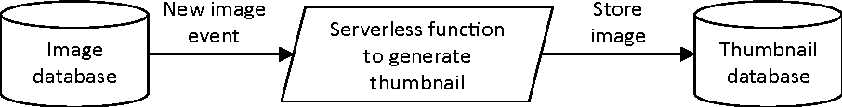
Event processing
Simple Image Processing Event handler function (Event based programming) has become “Hello World” for Serverless computing.
In case of failure, function can be executed again with no side effects.
Notes:
Each time a new file is uploaded to a folder, and event is generated and forwarded to the event handlers. Functions can be invoked again with no side effects.

Slide 48
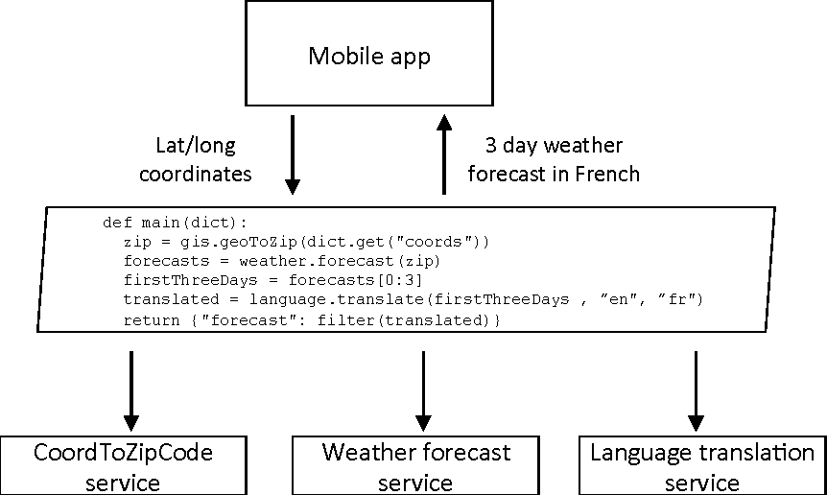
API composition
Application logic consists of data filtering and transformations.
Code to invoke API’s can be written in serverless functions.
Mobile app avoids the cost of invoking API’s multiple time over the network.
Offload filtering and aggregation to the backend.
Notes:
Serverless function can themselves act like an API
https://azure.microsoft.com/en-us/services/api-management/

Slide 49
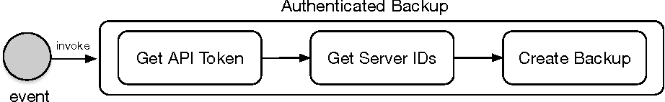
API aggregation to Reduce API calls
Not only helps in composition mechanism, but also helps to simplify the client side code that interacts with the aggregated call.
API’s in Openstack:
Require Client to first obtain an API token
Resolve the provider URL
Invoke required API call
Instead invoke only once using Backup:
Notes:
The mobile client now makes a single call to invoke this aggregate function.

Slide 50
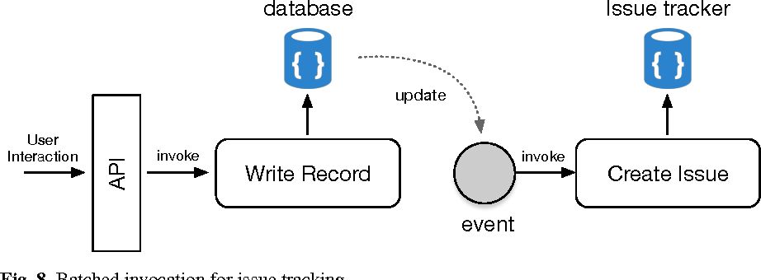
Flow control for Issue tracking
Serverless functions can be used to control the flow of data between 2 services.
Server not required to handle feedback requests.
Once sufficient number of updates are collected, we can batch them together into a single update in a controlled manner.
Notes:
Batch invocation for issue tracking…

Slide 51
Challenges and Open Problems:
System Level challenges
Programming Model and DevOps challenges
Open Research problems

Slide 52
System level challenges
Cost – Reducing the resource usage.
CPU bound computations vs I/O bound functions
Scaling – Serverless functions have no idea about the workload.
Security – Strong Isolation is required due to shared platform.
Legacy systems and serverless?
Hybrid model?
Notes:
Legacy systems: It should be easy to access data that is not on cloud using serverless platforms?
Hybrid model: one platform for all services???? Not possible

Slide 53
Programming model and DevOps Challenges:
Tools – Traditional tools are not useful for monitoring and debugging.
Monitoring and debugging
Short-lived functions, scaling to large invocations
Looking for problems is like finding needles in ever growing haystack?
Serverless IDEs? – High level IDE’s are needed.
Parallel execution of functions?
Managing state in stateless serverless function is not clear
Notes:
software development (Dev) with information technology operations (Ops). The goal of DevOps is to change and improve the relationship by advocating better communication and collaboration between these two business units.
Tools not able for monitoring and debugging apps
Declarative: Instructing what needs to be done instead of How is it to be done..
Ide – refactoring???

Slide 54
Open Research problems
What are boundaries of Serverless?
How FaaS fits into cloud?
How is Serverless model related to other models?
Can different models be mixed together?
Notes:
ServerAware: main distinction may be about caring about servers
ServerLess: not caring about server details
ServerAware compute has long time to live but take longer to provision new resources;
Serverless compute is optimized to work on multiple servers and hide server details.
Smart contracts are self-executing contracts with the terms of the agreement between buyer and seller being directly written into lines of code.
A smart contract is a computer code running on top of a blockchain containing a set of rules under which the parties to that smart contract agree to interact with each other. If and when the pre-defined rules are met, the agreement is automatically enforced.

Slide 55
Open Research problems - New Tooling needed?
New tools are needed to deal with more precise details of the Applications.
Debugging is much different if instead of having one artifact (a micro-service or traditional monolithic app) developers need to deal with a myriad of smaller pieces of code …
That haystack can grow really big really fast ...
Notes:
Granularity of serverless is much smaller than traditional server based tool.
No direct access to servers what went wrong

Slide 56
Open Research problems - Can “legacy” code be made to run serverless?
Today the amount of existing (“legacy”) code that must continue running is much larger than the new code created specifically to run in serverless environments.
The economical value of existing code represents a huge investment of countless hours of developers coding and fixing software.
Till what extent can the existing code be used to solve problems?

Slide 57
Open Research problems - Is serverless fundamentally stateless?
Current serverless platforms are stateless will there be stateful serverless services in future?
Will there be simple ways to deal with state?
Can there be serverless services that have stateful support built-in
And with different degrees of quality-of-service?

Slide 58
Conclusion:
Recent Research done in Serverless computing has been discussed.
Serverless computing is a trend towards higher level of abstractions in cloud programming models – FaaS.
3 major cloud computing vendors are shifting to Serverless computing.
Currently, there are a wide variety of technical challenges starting from Infrastructure level to Optimization level.
Notes:
Microaoft, Amazon, and IBM

Slide 59
Thank you for your attention.

